Slide 1

KGiSL INSTITUTE OF TECHNOLOGY
COIMBATORE
Department of Computer Science & Engineering
“Title : RansomGuard”
TEAM MEMBERS:
1. Manoj N 711720104040
2. Mohammed Bashid A 711720104045
3. Naveen G 711720104050
4. Selva Ganapathi N 711720104309
UNDER THE GUIDANCE OF:
Ms.Nithya.V M.E

Slide 2

agenda
Abstract
Existing application
Literature Survey
Proposed System
Architectural Diagram
Module split-up
Key Tools
Expected output
Reference
Time Line

Slide 3
Abstract
Our project aims to develop a robust ransomware detection tool for the growing threat of ransomware attacks. The tool monitors network traffic, endpoint activity, and system logs to identify ransomware behaviors and indicators of compromise. It provides alerts, customizable dashboards, and integration with existing security infrastructure to enable proactive threat detection and response. Through continuous monitoring, analysis, and refinement, our ransomware detection tool strengthen their defenses against ransomware attacks, safeguard critical assets, and minimize the impact of ransomware incidents. By empowering security teams with the tools and insights needed to detect and mitigate ransomware threats proactively, our solution contributes to enhancing overall cyber security posture and resilience in the face of evolving cyber threats.

Slide 4
EXISTING SYSTEM
Relies on known signatures of ransomware variants, making it ineffective against polymorphic malware.
Lacks advanced behavioral analysis capabilities to detect subtle ransomware behaviors or anomalies.
Often focuses on perimeter security, neglecting endpoint and user behavior monitoring.
High rate of false positives or negatives, leading to alert fatigue or missed detections.
Limited visibility and context for effective incident response and mitigation.

Slide 5
Literature Survey
TITLE | PUBLICATION YEAR | AUTHOR / PUBLISHER | DESCRIPTION
“Ransomware Anti-Analysis and Evasion Techniques” | 2021 | Mohammad N. Olaimat, Mohd Aizaini Maarof, Bander Ali S. Al-rimy | Survey and Study of Ransomware
"Evolution of ransomware” | 2018 | P O'Kane, S Sezer, D Carlin | Origin and improvement of Ransomware Techniques.
"Ransomware: A growing menace” | 2012 | G O'Gorman, G McDonald | Effects of Ransomware
"Comparative analysis of various ransomware virii" | 2010 | A Gazet | Study of various Virus Research and Defense

Slide 6
PROPOSED SYSTEM
Utilize advanced techniques to detect ransomware activity.
Monitor file access patterns, process behavior, and communication with command-and-control servers.
Analyze network traffic for signs of ransomware activity, such as large file transfers or unusual connections.
Develop the detection tool using appropriate programming languages and frameworks.
Test the tool in simulated environments to ensure accuracy and reliability.

Slide 7
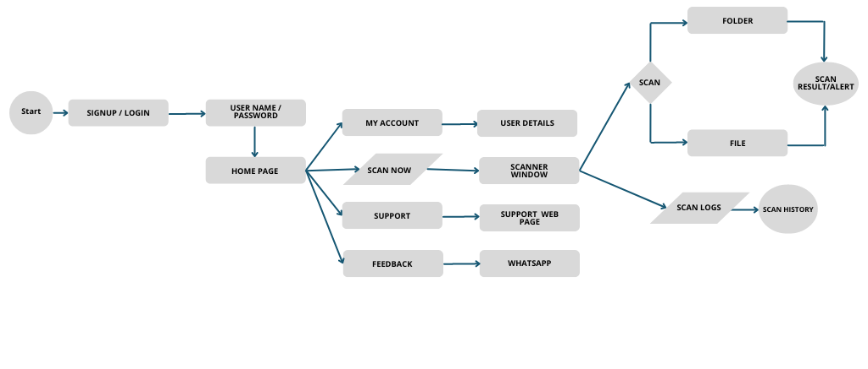
Architectural Diagram

Slide 8
EXPECTED OUTCOME
Developing a user-friendly ransomware detection tool capable of accurately identifying ransomware activity is the primary objective.
This tool will provide real-time alerts, actionable insights, and effective incident response capabilities, thereby enhancing cyber security resilience.
Key features include seamless integration with existing security infrastructure, continuous improvement through updates to address emerging threats, and comprehensive documentation and training materials to facilitate easy adoption and usage by security teams.

Slide 9
Module
Sign up and Login Page
Home Page
My account and Feed back
Support
Scanner and Risk Detection.

Slide 10
Key Tools
Integrated Development Environment (IDE):
Visual Studio Code
PyCharm
Programming Languages:
Python
Version Control:
Git/Git Hub
PROJECT– THIRD REVIEW Department of CSE, KGiSL Institute of Technology, Coimbatore

Slide 11
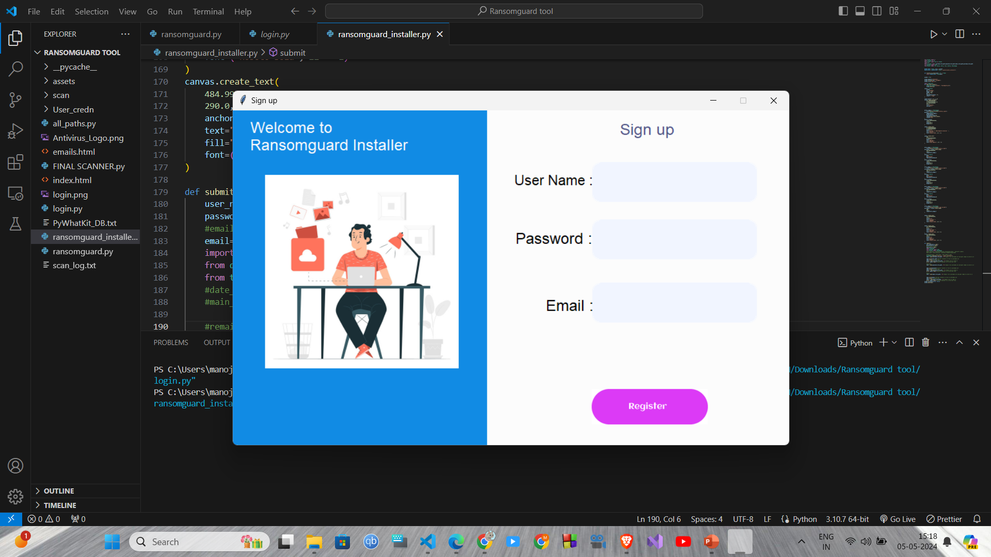

Slide 12
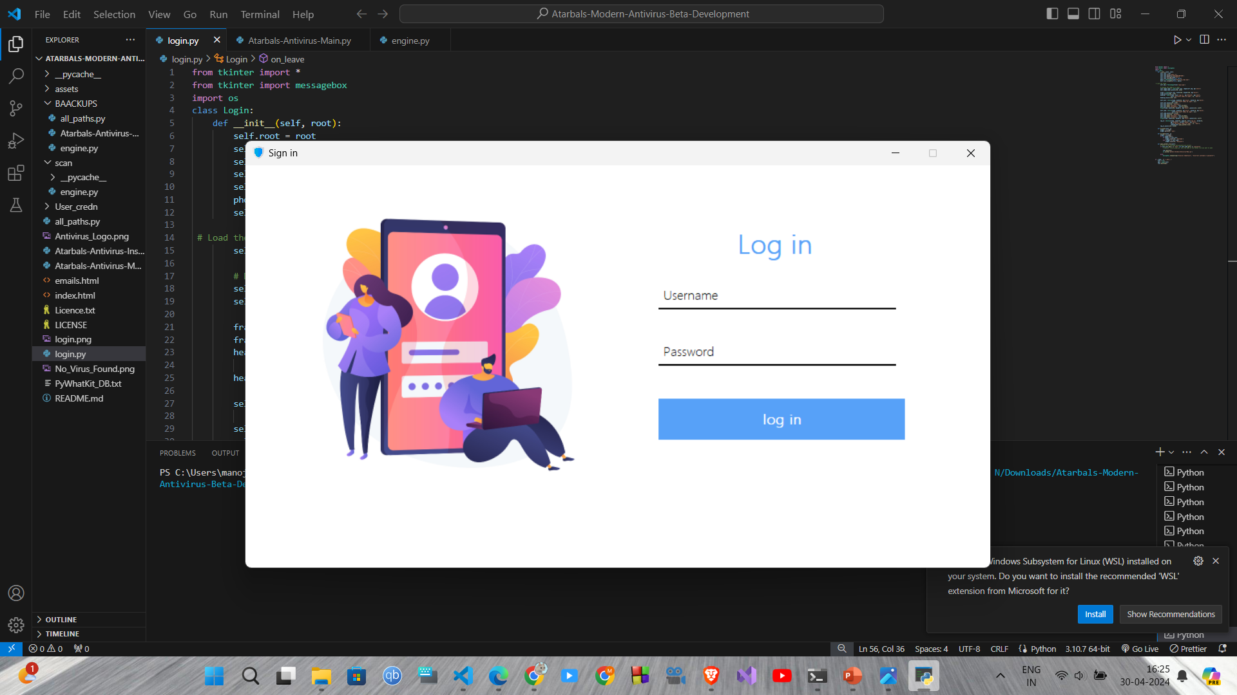

Slide 13
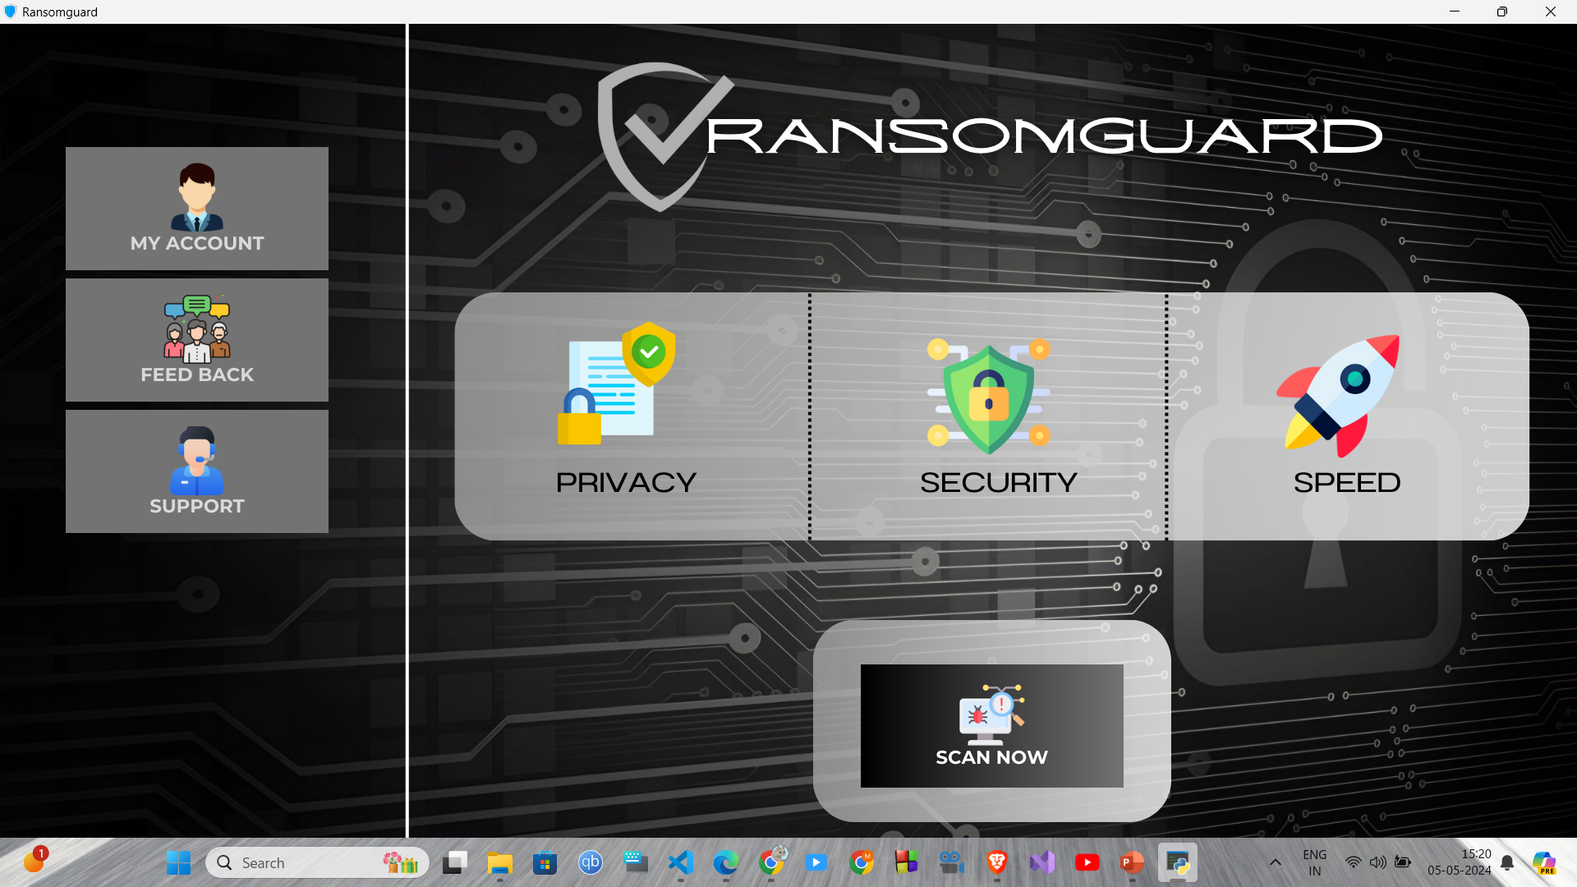

Slide 14
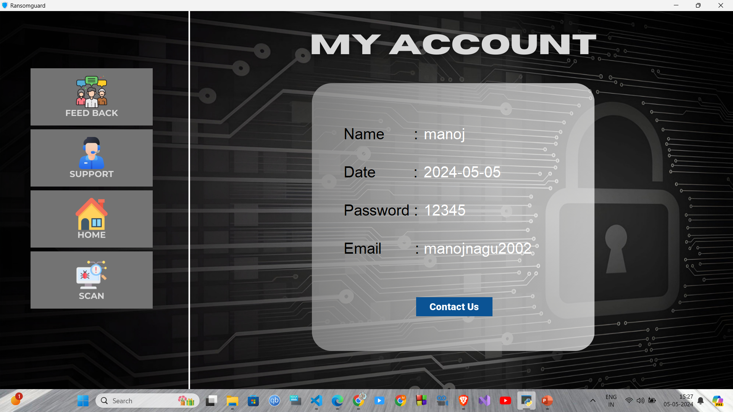

Slide 15
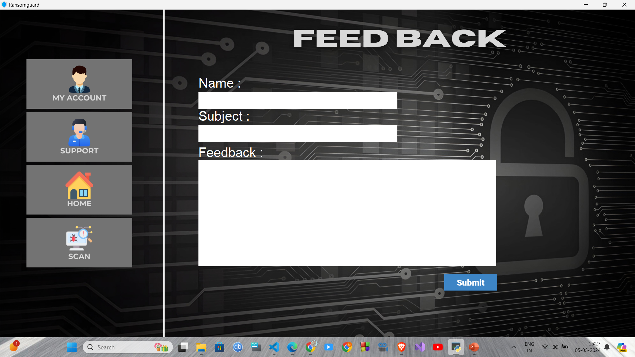

Slide 16
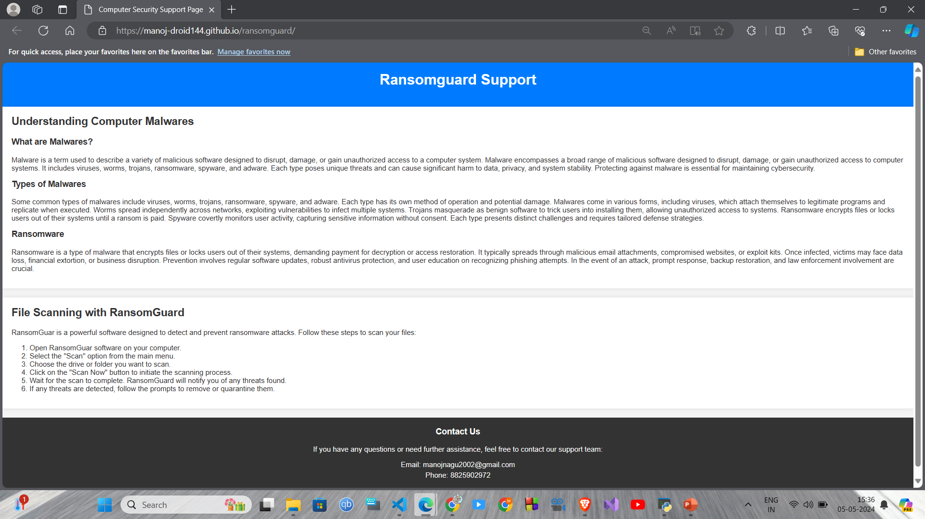

Slide 17
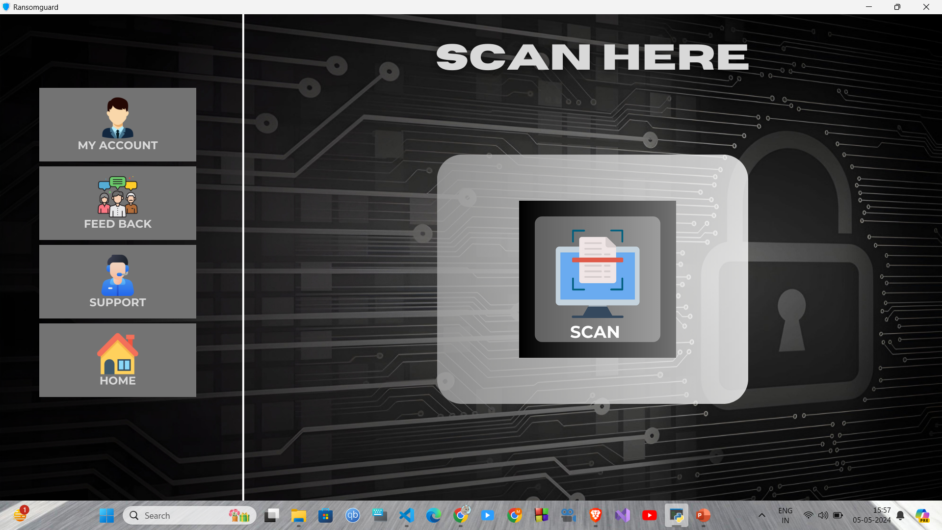

Slide 18
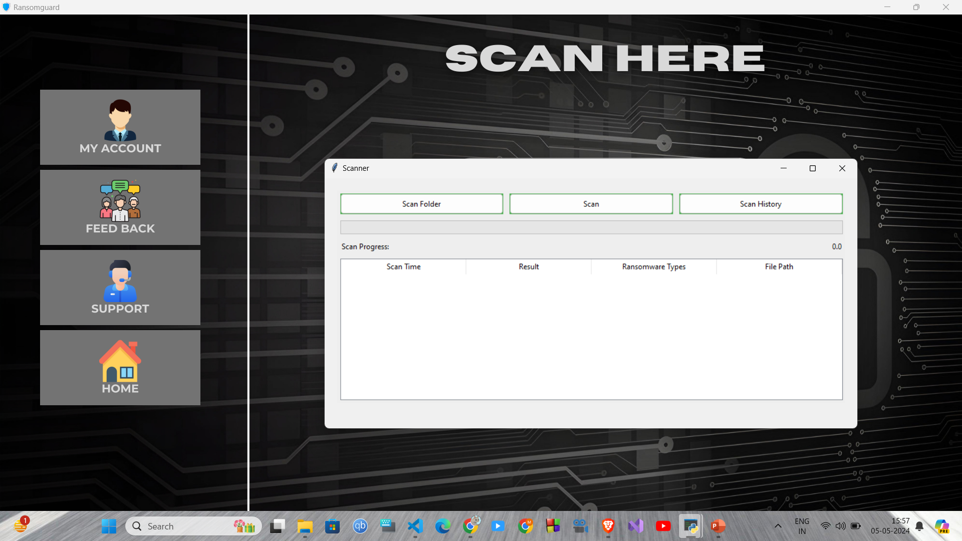

Slide 19
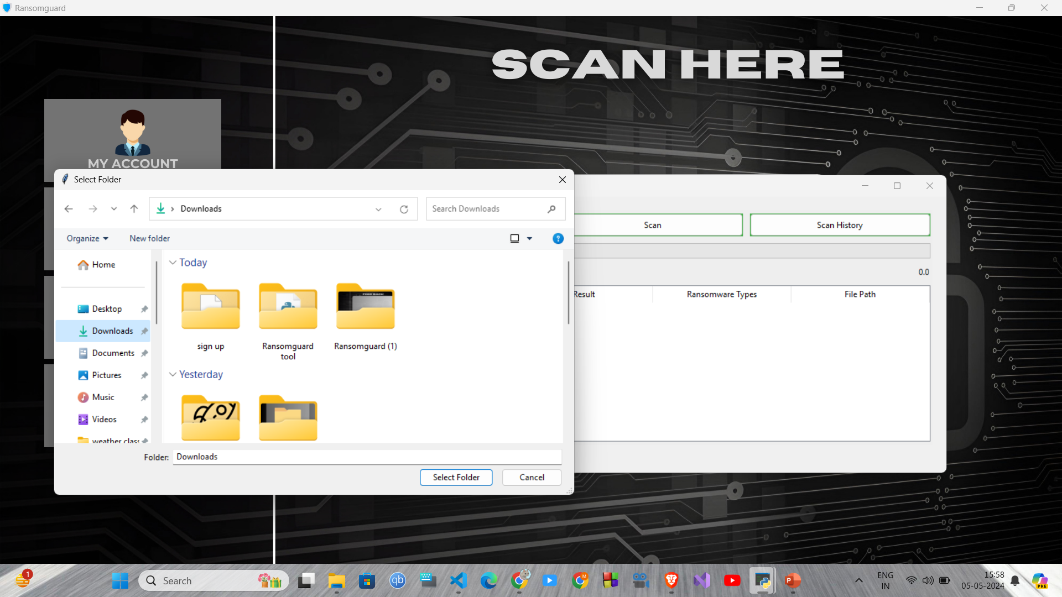

Slide 20
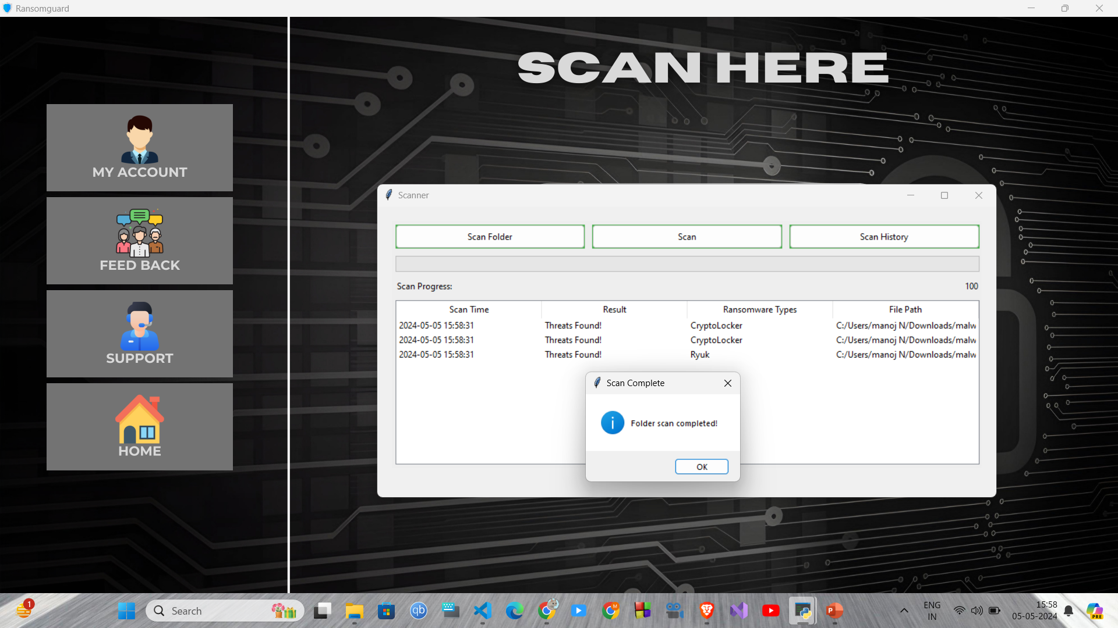

Slide 21
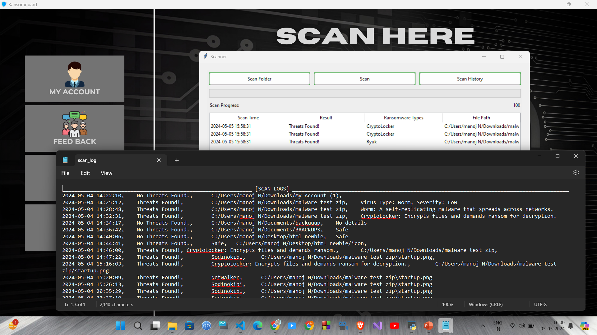

Slide 22
REFERENCE
"Practical Malware Analysis: The Hands-On Guide to Dissecting Malicious Software" by Michael Sikorski and Andrew Honig - Vol 1 163/802 - ISBN : 9781593272906
"Machine Learning and Security: Protecting Systems with Data and Algorithms" by Clarence Chio and David Freeman – Vol 2 - 105/520 - ISBN : 9781491979853
"The Art of Computer Virus Research and Defense" by Peter Szor – vol 1 118/882
ISBN: 9780672333903

Slide 23
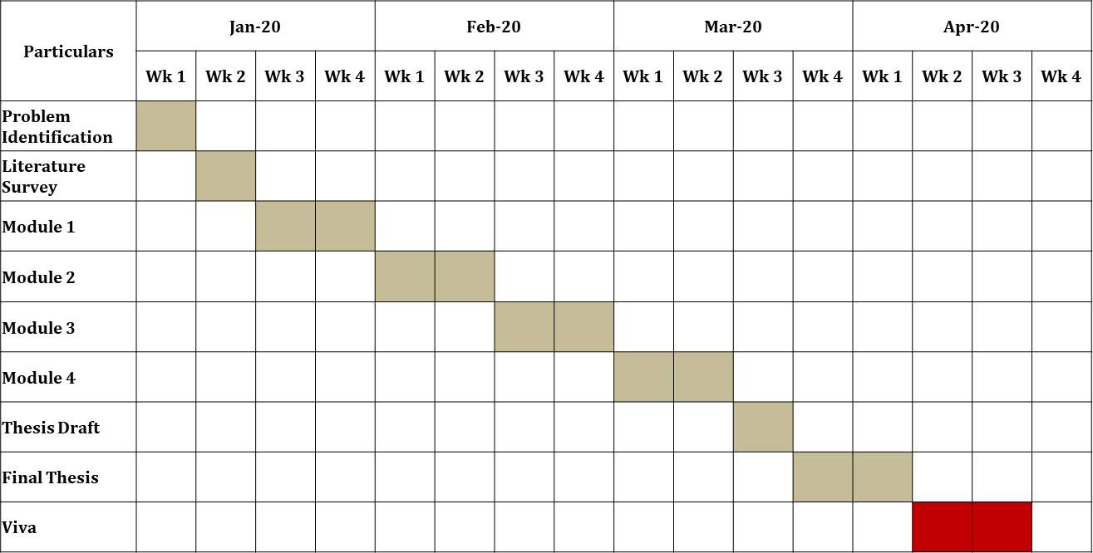
TIME LINE
Feb 24
Feb 24
Apr 24
Mar 24
Module 5

Slide 24
THANK YOU

